Slide 1
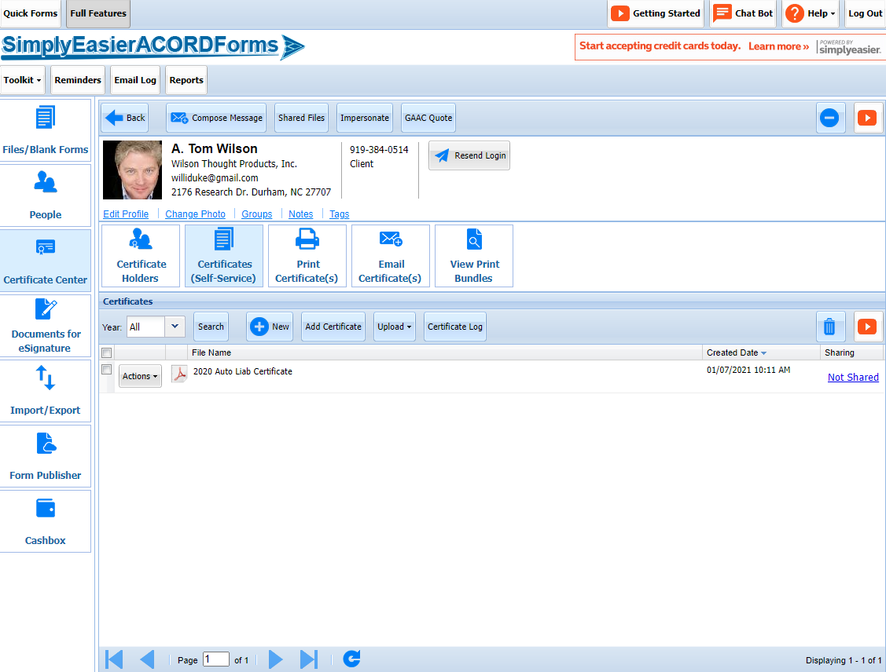
Certificate Center – Decision to Use
2 Ways to Create Certificate
From New Blank Forms
From Certificate Center
Which to Use
If you just need one Certificate ever for this insured, use New Blank Forms
If you will be issuing more than one certificate ever, use Certificate Center

Slide 2
Certificate Center
You can work in Certificate Center by selecting the Certificate Center button on the left menu
Certificate Center Menu Button

Slide 3
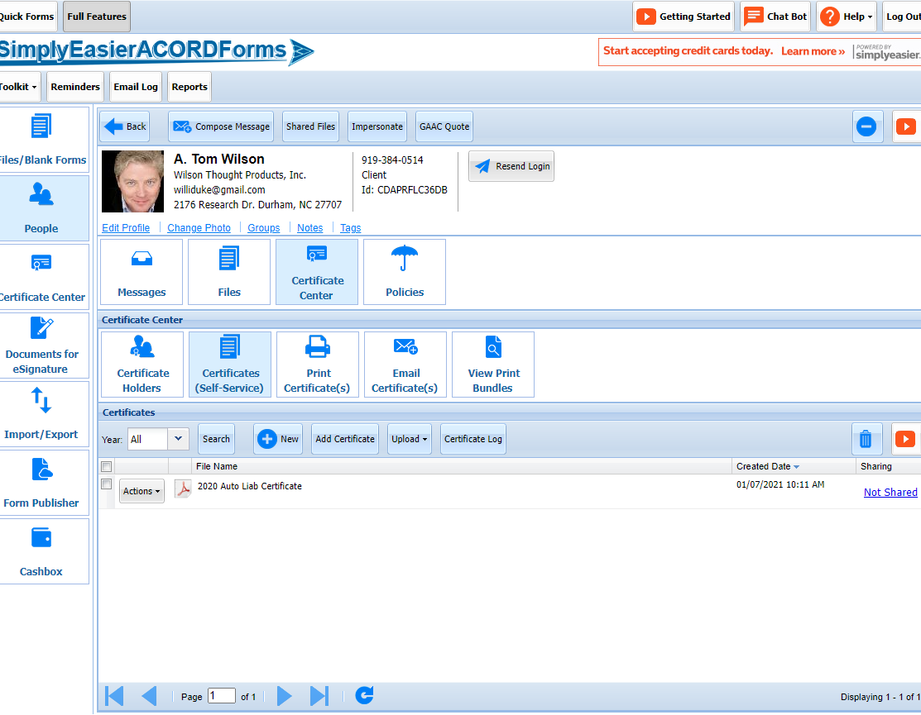
Certificate Center
You can select your insured from the People Button
Then Select Certificate Center from within the People Screen
People Button
Certificate Center

Slide 4
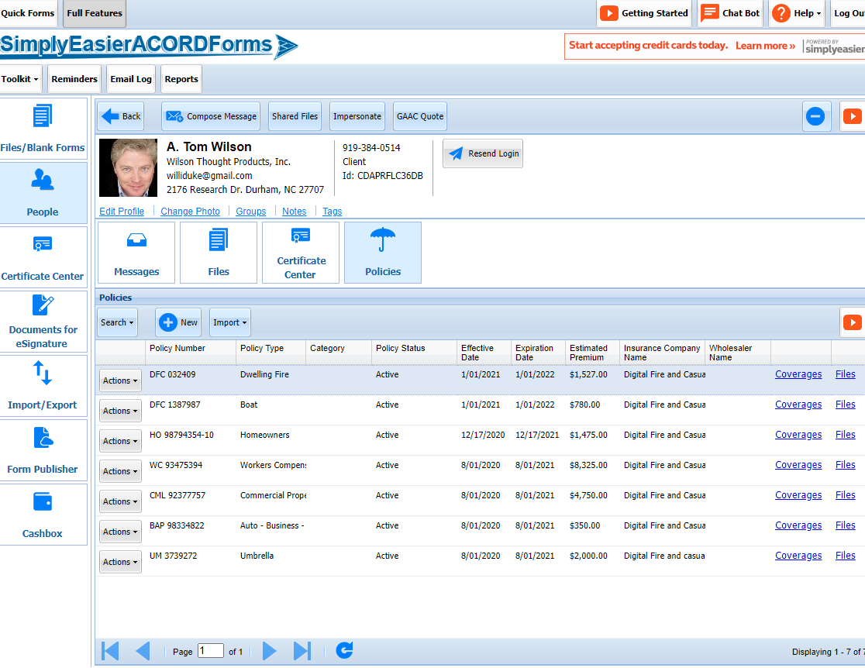
Certificate Center – Basic Information
If you are creating a Certificate for the first time for an insured and their policies, you will make future certificates incredibility easier by taking the time now to add:
Policy Information
Certificate Holders
You add Policy Information from the People Profile section
Policy Information

Slide 5
Certificate Center – Policy Information
Select the Policy Button and Select New
New

Slide 6
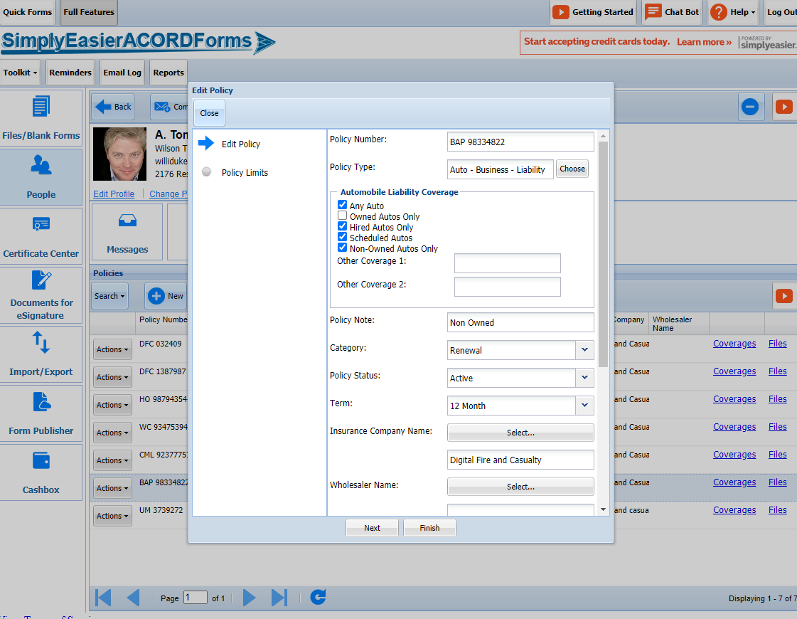
Certificate Center – Policy Information
Complete the 1st screen and click Next

Slide 7
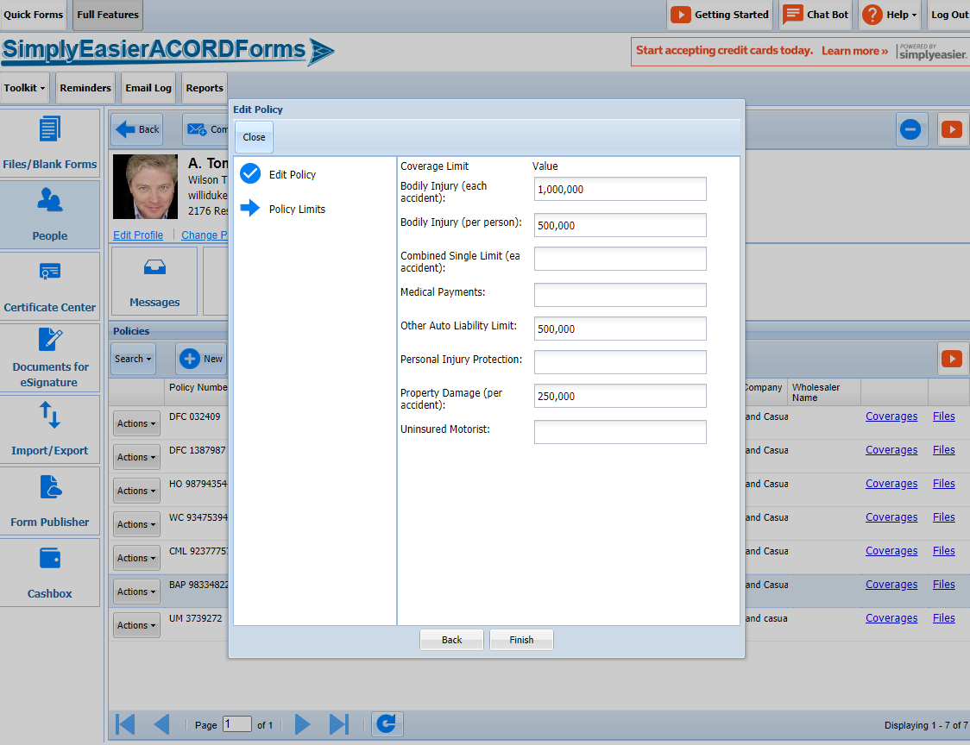
Certificate Center
Complete the additional Screens and Save
IMPORTANT
Policy Info enter here can be pulled directly into other forms – Certificates of Ins or Applications.
Data does not flow from forms into this space.

Slide 8
Certificate Center – Create New Certificate
From Certificate Center Select “New”
New

Slide 9
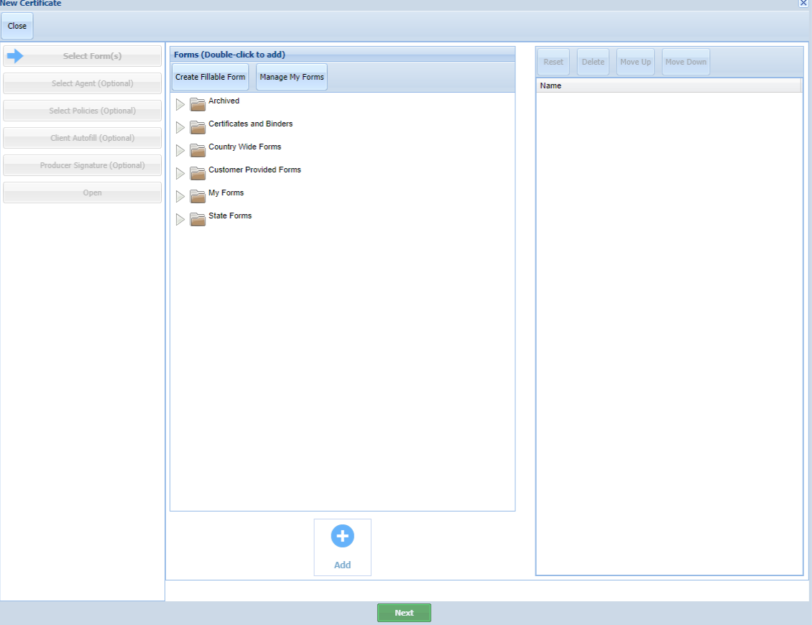
Certificate Center – Create New Certificate
This takes you to choice of forms.
Select Certificate and Binders Folder
Certificate and Binders Folder

Slide 10
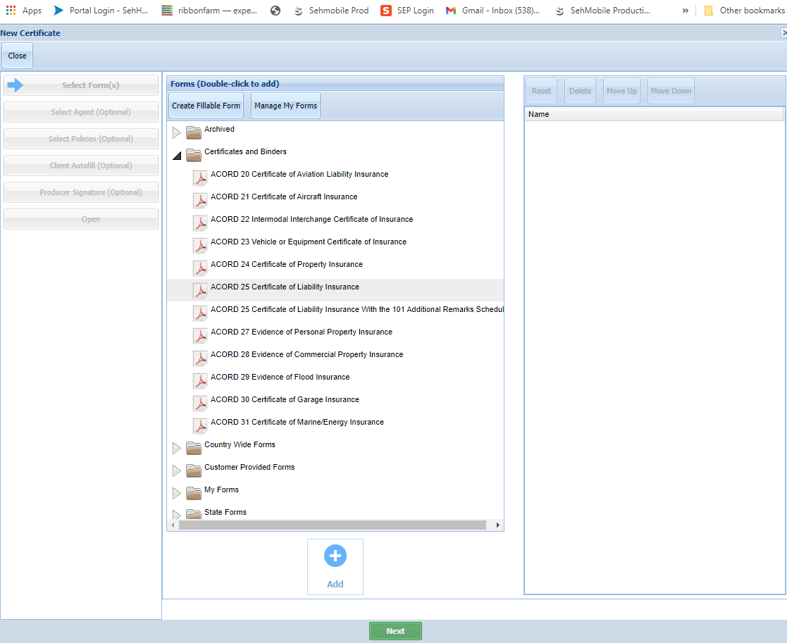
Certificate Center – Create New Certificate
I am selecting the ACORD 25 Certificate of Liability

Slide 11
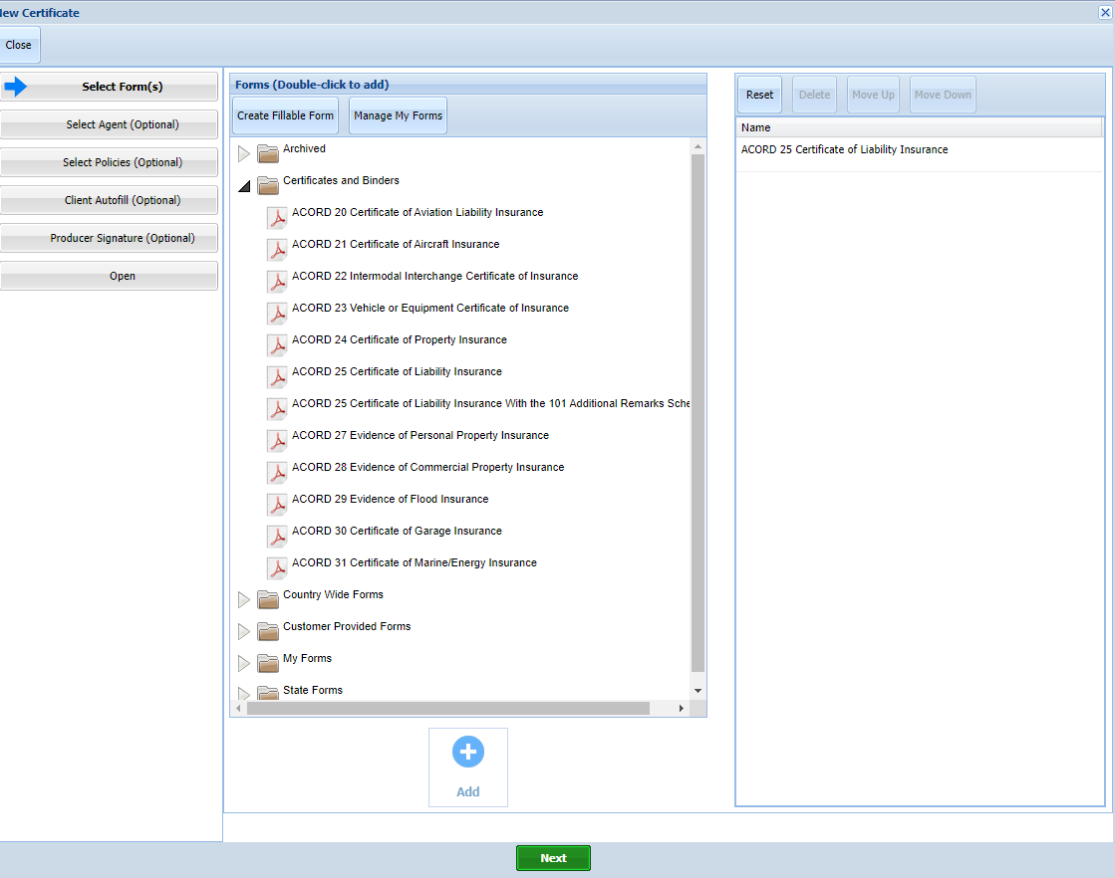
Certificate Center – Create New Certificate
I highlight the selected form and either double click on it or click on the green add button at the bottom of the screen.
This moves the file into the right hand box.
Then click NEXT at bottom of screen.
File Moved

Slide 12
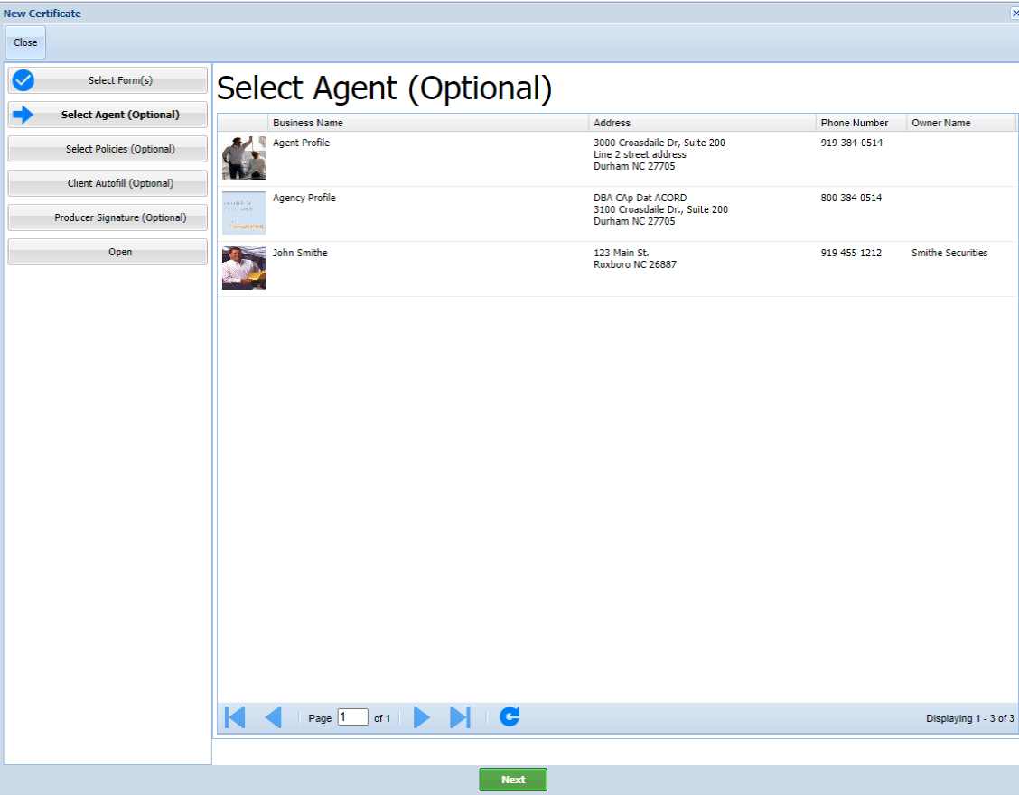
Certificate Center – Create New Certificate
Next screen asks you to select the agent or agency profile to be inserted into the certificate.
Select then click Next

Slide 13
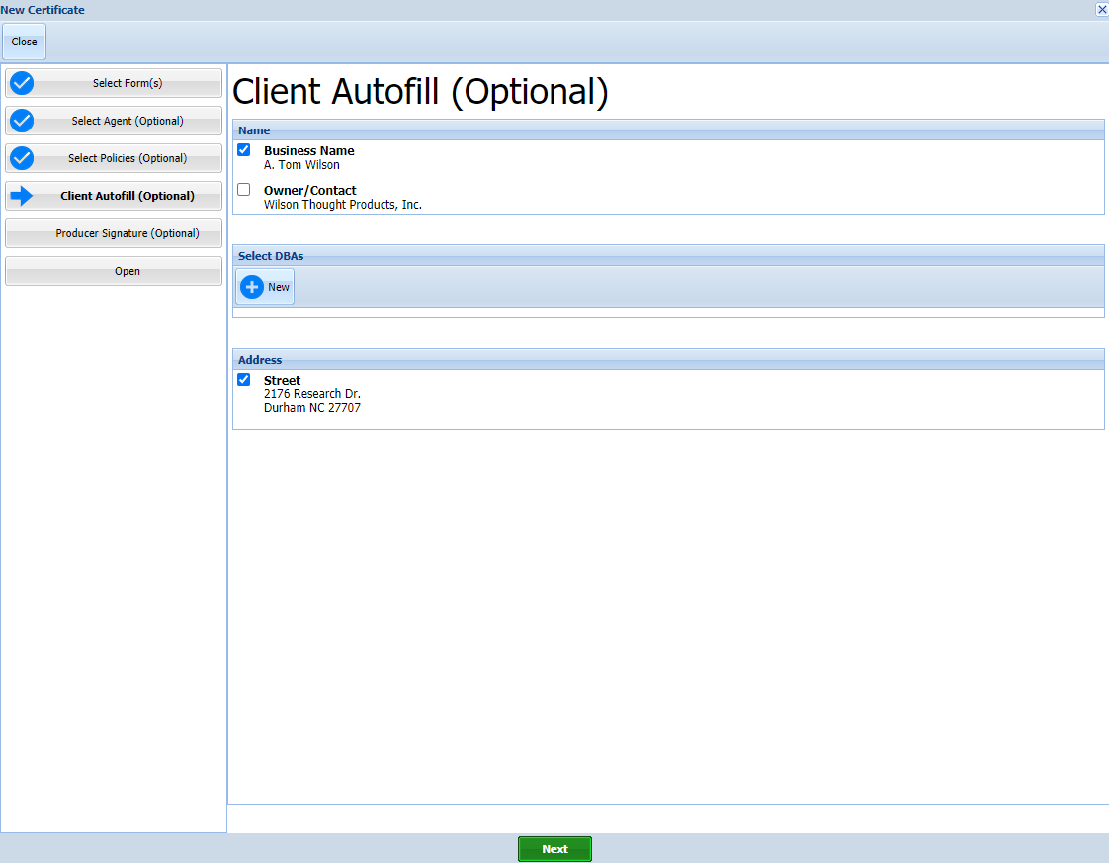
Certificate Center – Create New Certificate
Next screen asks you to Select Client

Slide 14
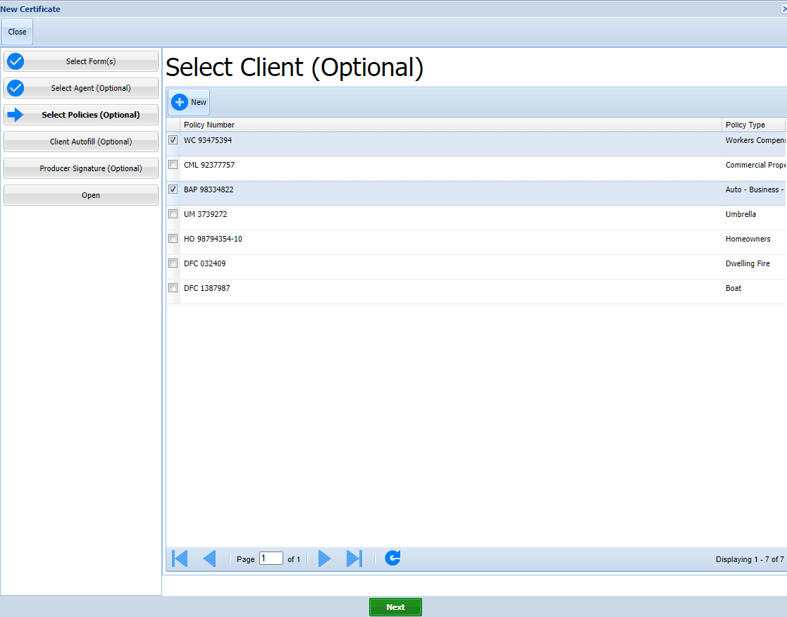
Certificate Center – Create New Certificate
Next screen asks you to Select polices for this client to auto fill into the Certificate
I select the Workers Comp and the Business Auto policies

Slide 15
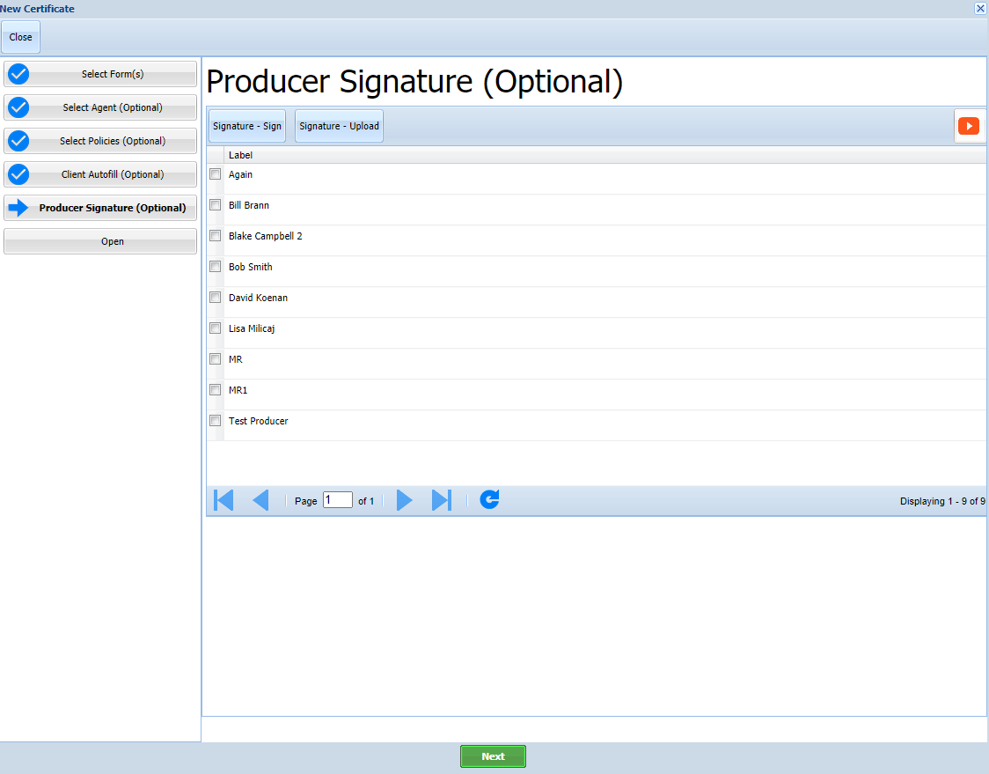
Certificate Center – Create New Certificate
Next you are asked to select a stored producer signature to be added.
You will have another chance to do this, but I am adding Bob Smith for demonstration purposes.
Click check box to select stored signature

Slide 16
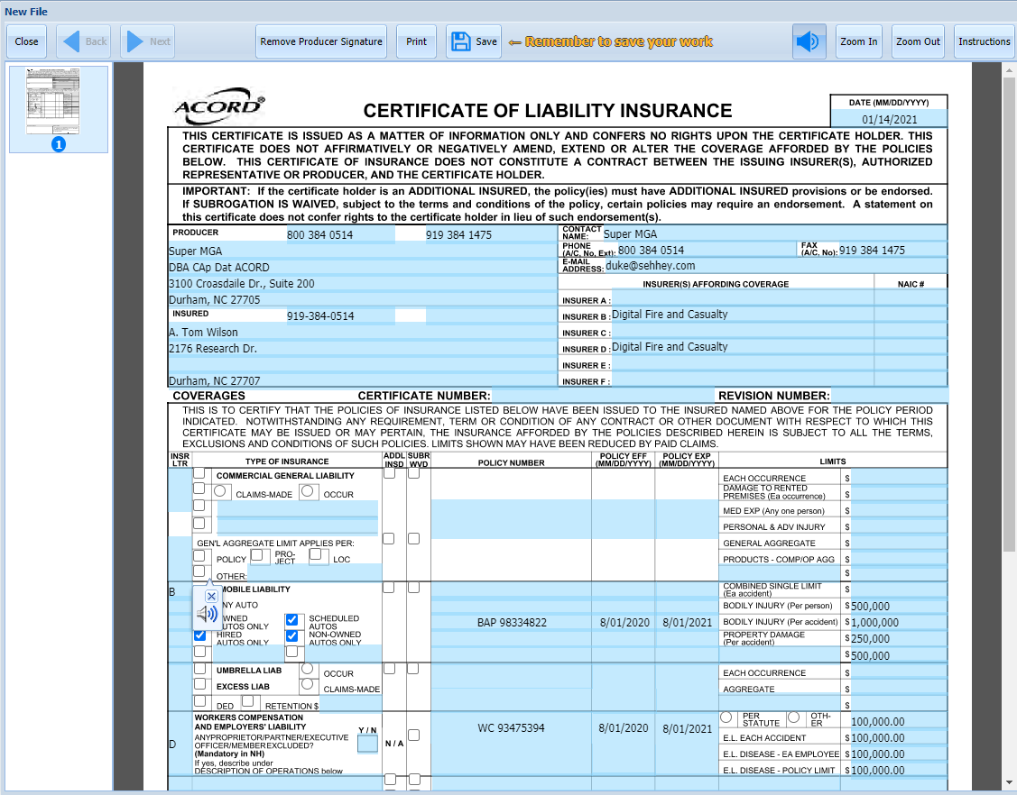
Certificate Center – Create New Certificate
The prefilled Certificate of Insurance opens.

Slide 17
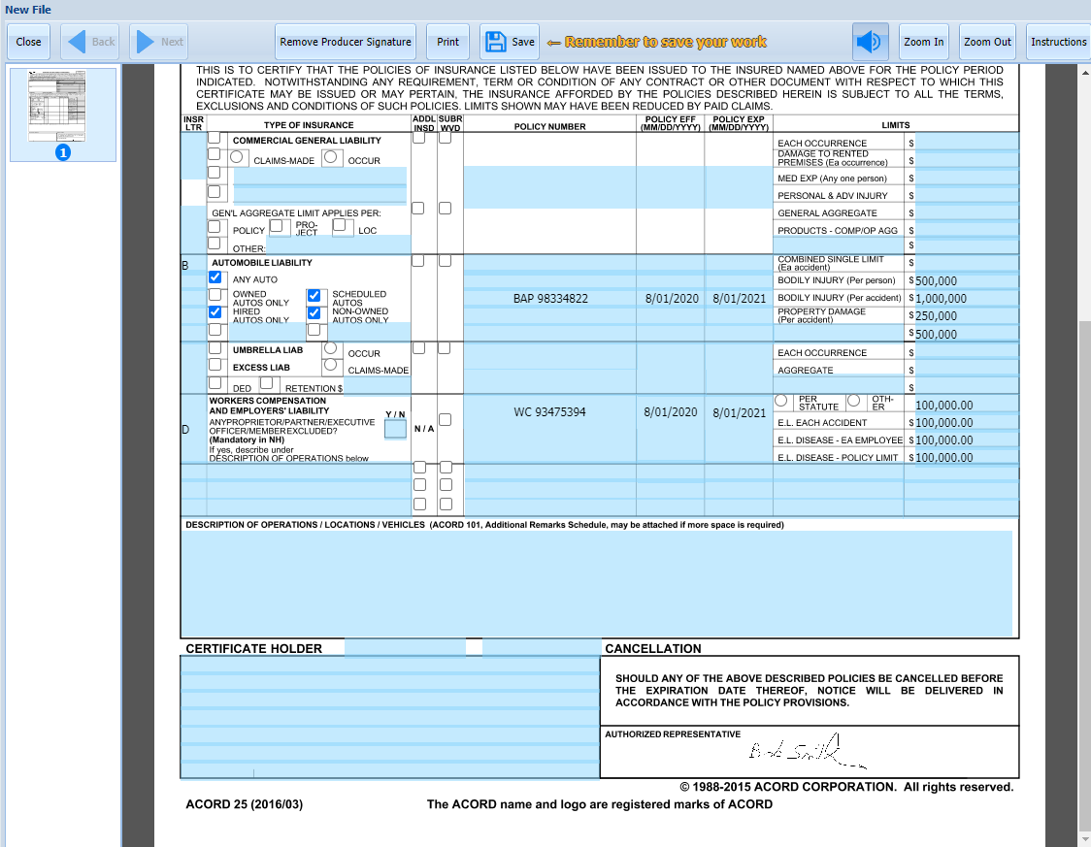
Certificate Center – Create New Certificate
Notice the Added Signature
Notice no Certificate Holder has been added. You can type that at this point.
I am going to show you how to set Certificate Holders up to pre-fill.

Slide 18
Certificate Center – Create New Certificate
Be certain to SAVE your form!!!
Save!!!!

Slide 19
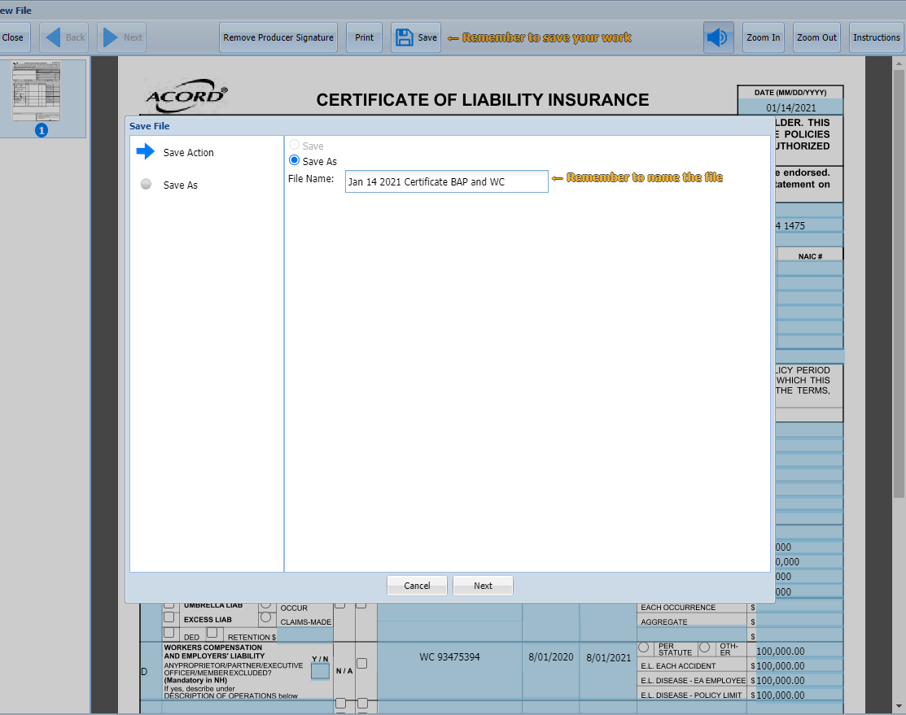
Certificate Center – Create New Certificate
Save with a unique name which will make it easy for you to remember what this form is.

Slide 20
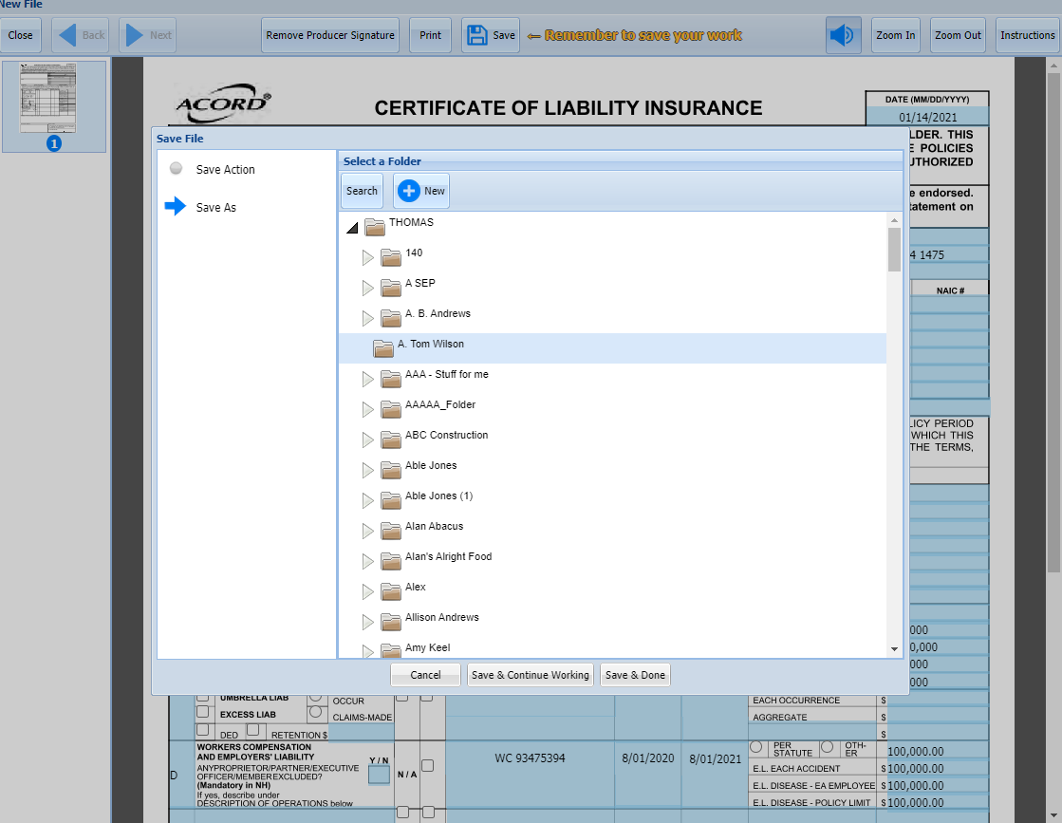
Certificate Center – Create New Certificate
Save the form into the Folder for this insured.

Slide 21
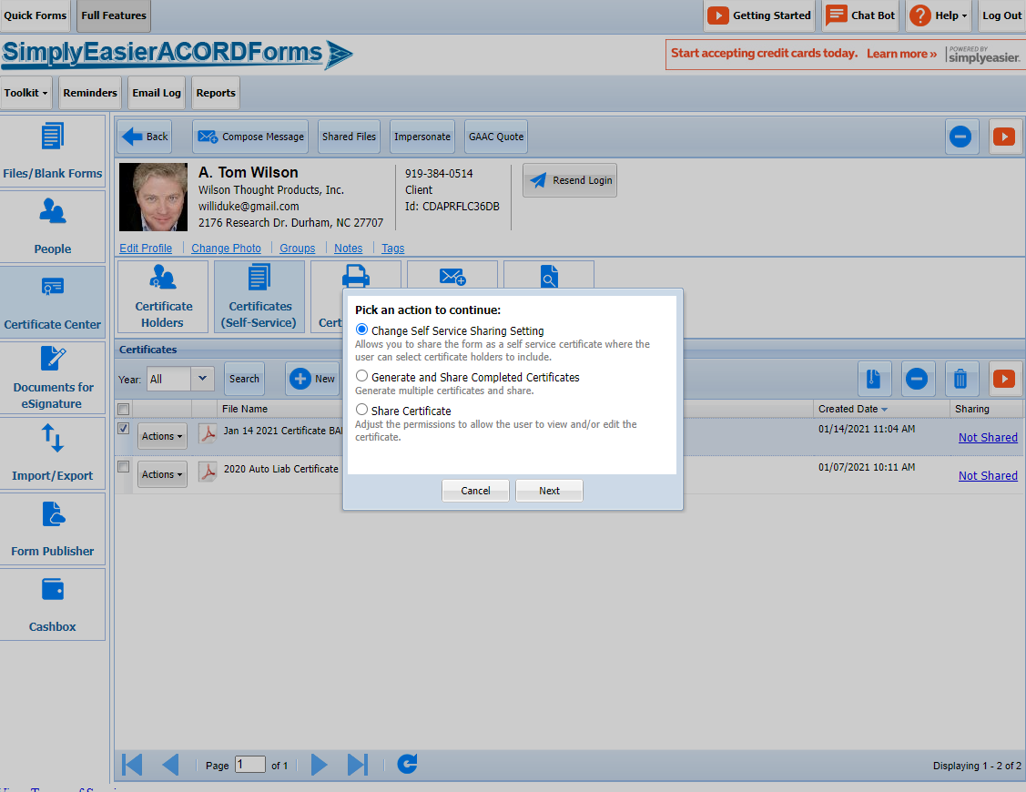
Certificate Center – Create New Certificate
To have Certificate Holder(s) autofill…
Select the Saved Certificate
Click on the Sharing column link
Select the Top Option in the Pop Up
Sharing Permissions
Select Certificate
Sharing Link

Slide 22
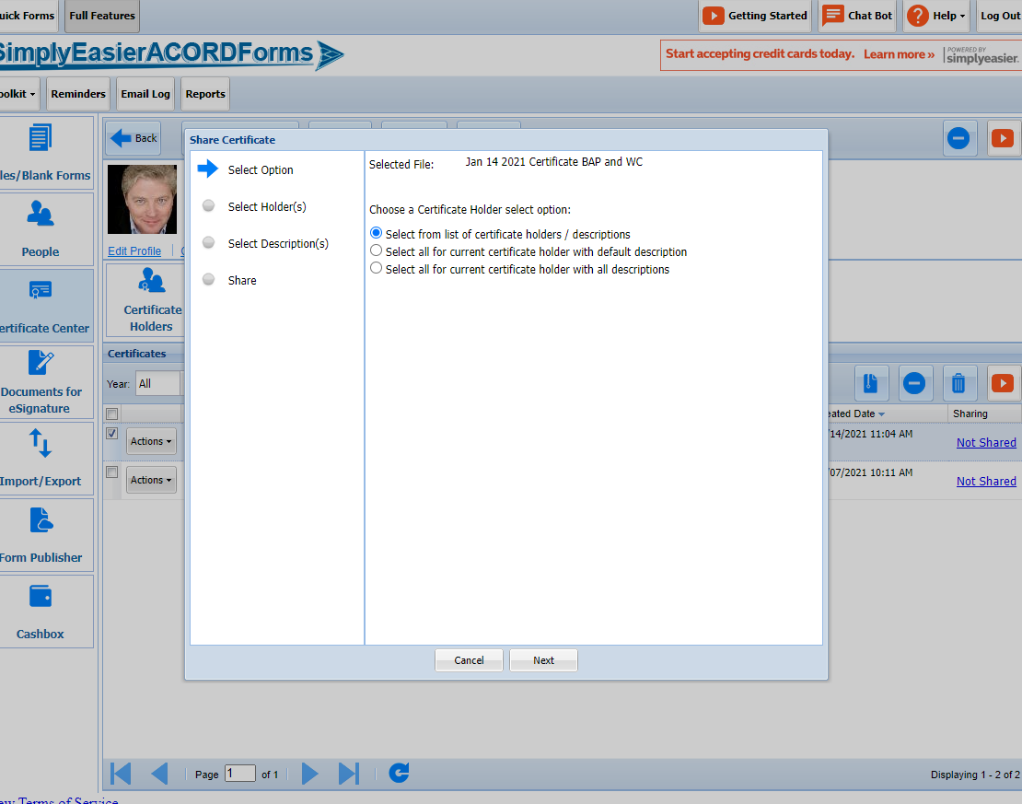
Certificate Center – Create New Certificate
Select appropriate Option
I am choosing the first

Slide 23
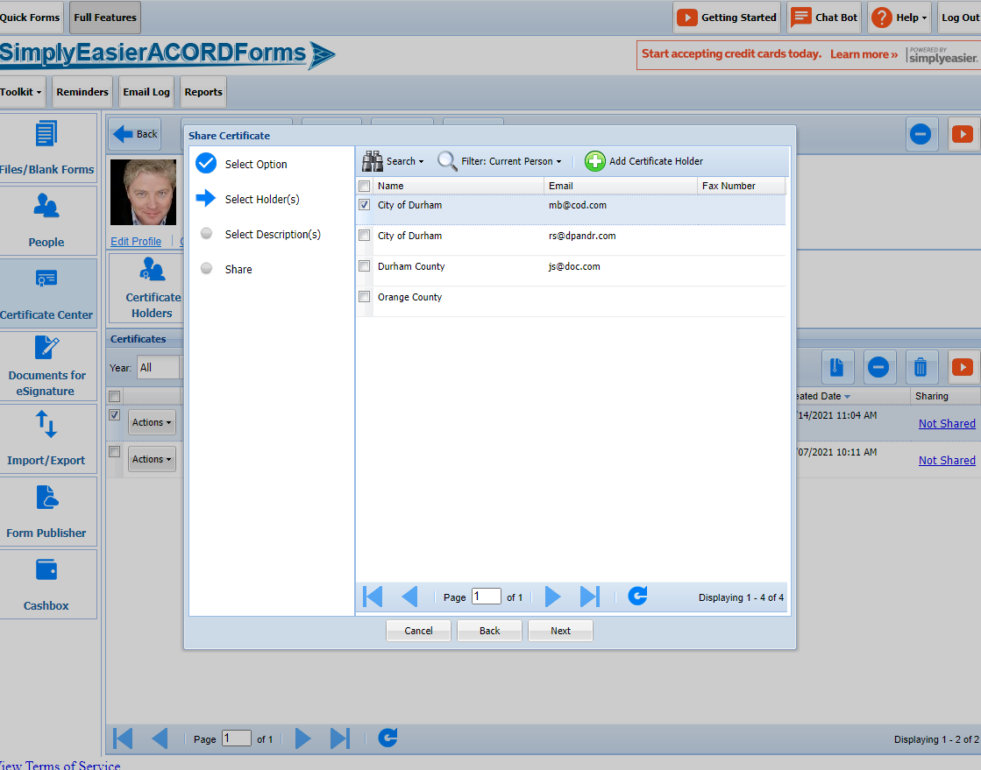
Certificate Center – Create New Certificate
A list of existing Certificate Holders appears
Check the boxes for the Certificate Holder to whom you want to send the Certificate.
NOTE: You can send to as many as you want – a major time saver.

Slide 24
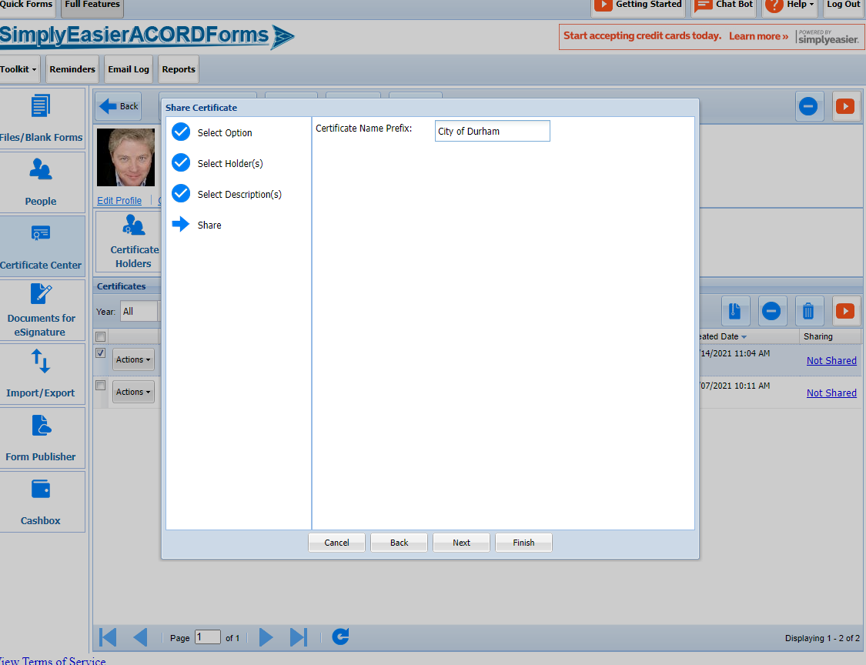
Certificate Center – Create New Certificate
Add a Certificate Prefix
This allows you to store each specific certificate holder issued certificate uniquely.
The prefix will be followed by a sequential number in the new name of this issued / shared certificate

Slide 25
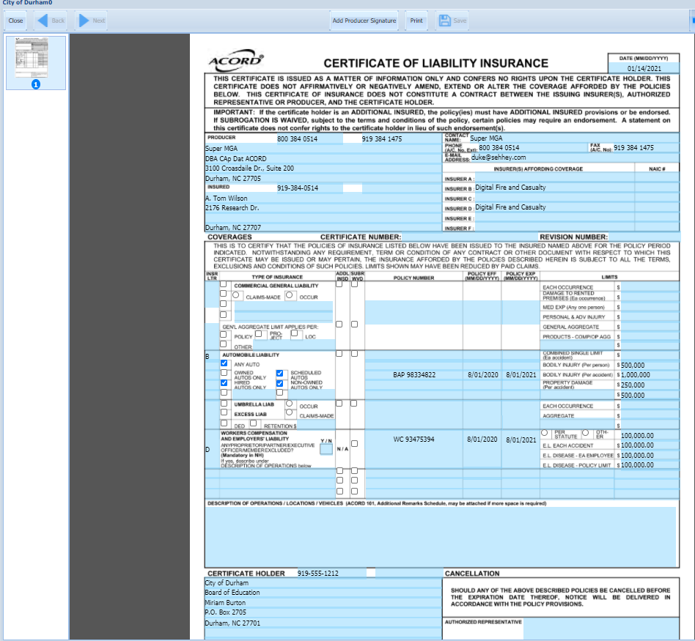
Certificate Center – Create New Certificate
The new Certificate with the Certificate Holder shown opens.
NOTICE: The Signature is not longer in the Certificate. This is to protect the Signature for being used without permission.
You will need to add the Signature again.
Add Signature
Certificate Holder Inserted

Slide 26
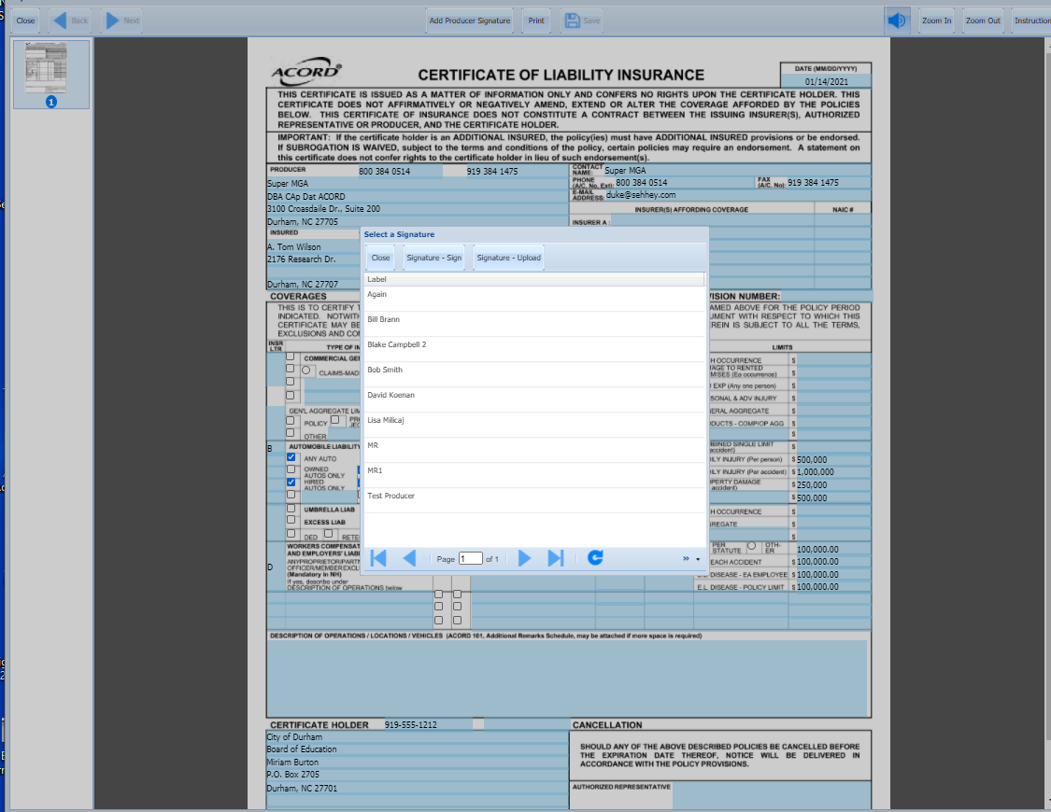
Certificate Center – Create New Certificate
Select Signature from list

Slide 27
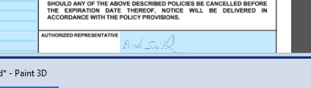
Certificate Center – Create New Certificate
Signature Added

Slide 28
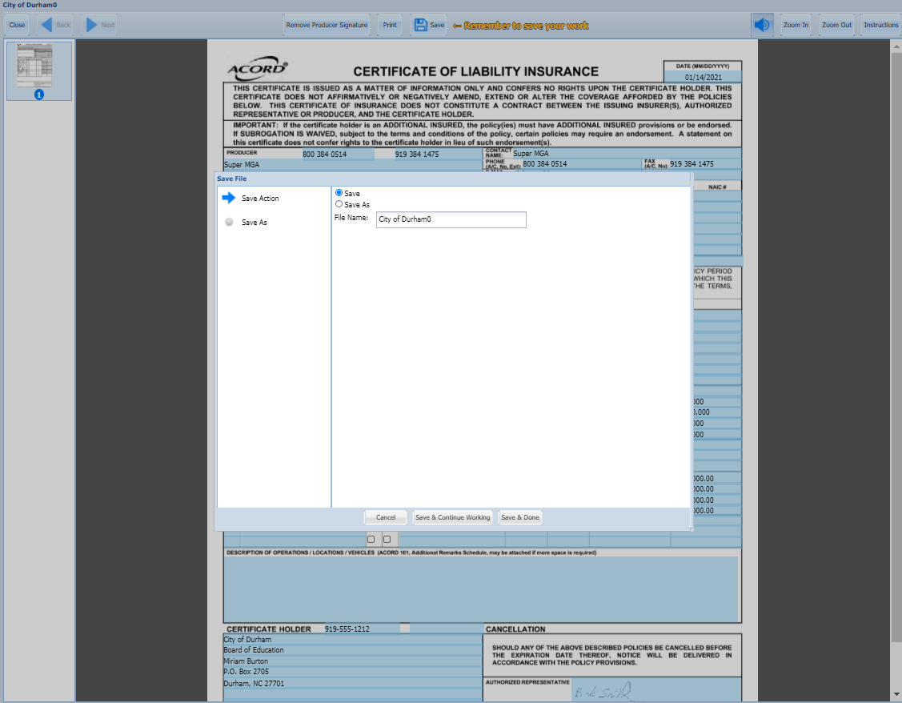
Certificate Center – Create New Certificate
Save Form
Notice the prefilled name if the Prefix I gave this form – City of Durham – plus the number “0” as this is the first of what could have been many certificates to many certificate holders.

Slide 29
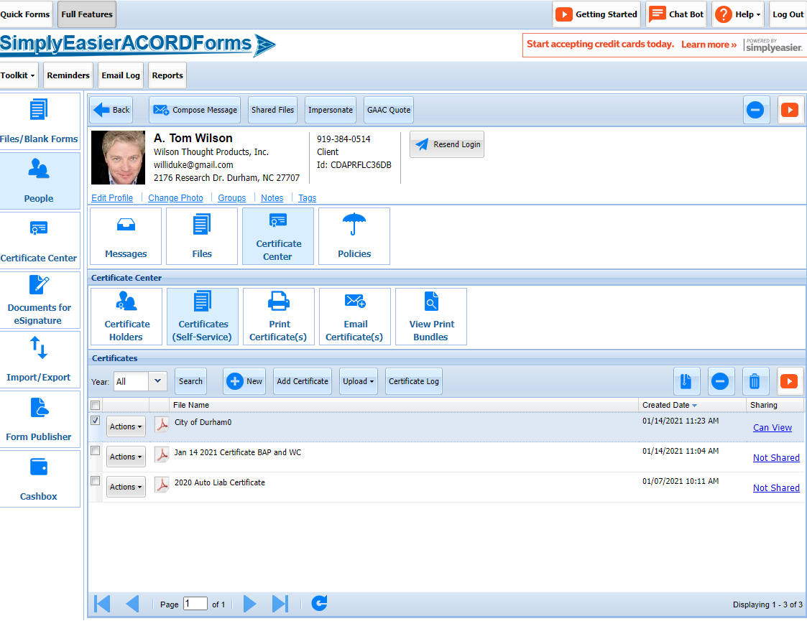
Certificate Center – Create New Certificate
The New Certificate will show in both the Certificate Center and the Forms section, but…
To see the new Certificate you will need to refresh the screen or go to another screen in the program and then come back to this screen.

Slide 30
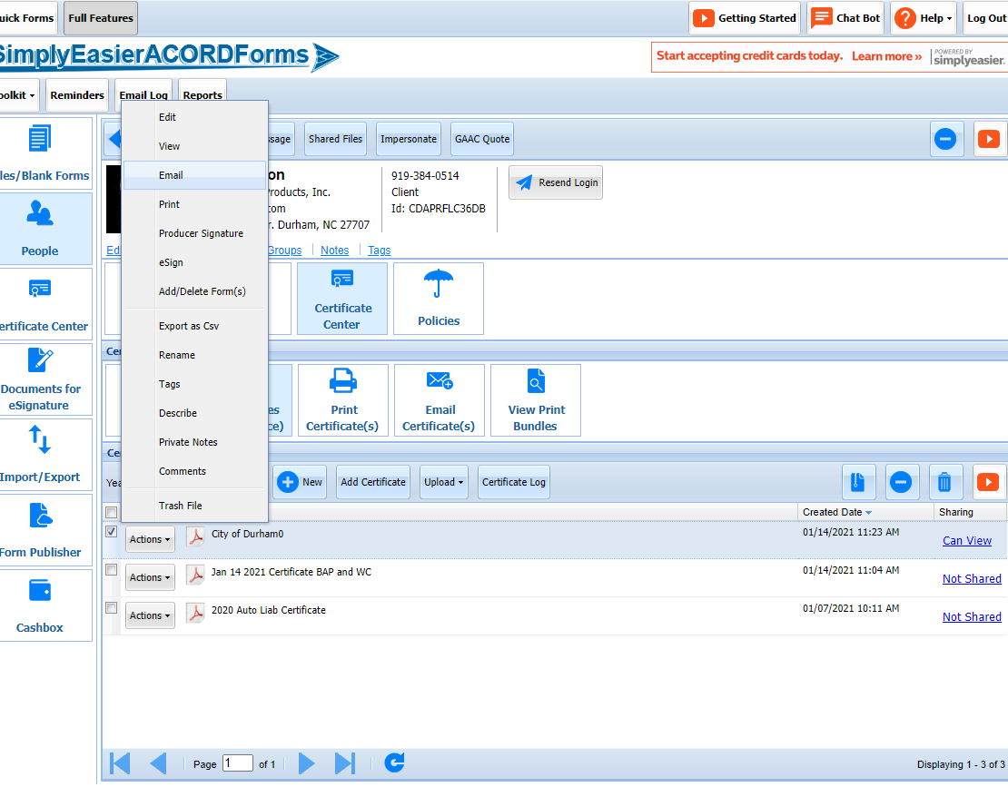
Certificate Center – Email Certificate
Select the Certificate with which you want to work
From the “Actions” drop down menu Select Email

Slide 31
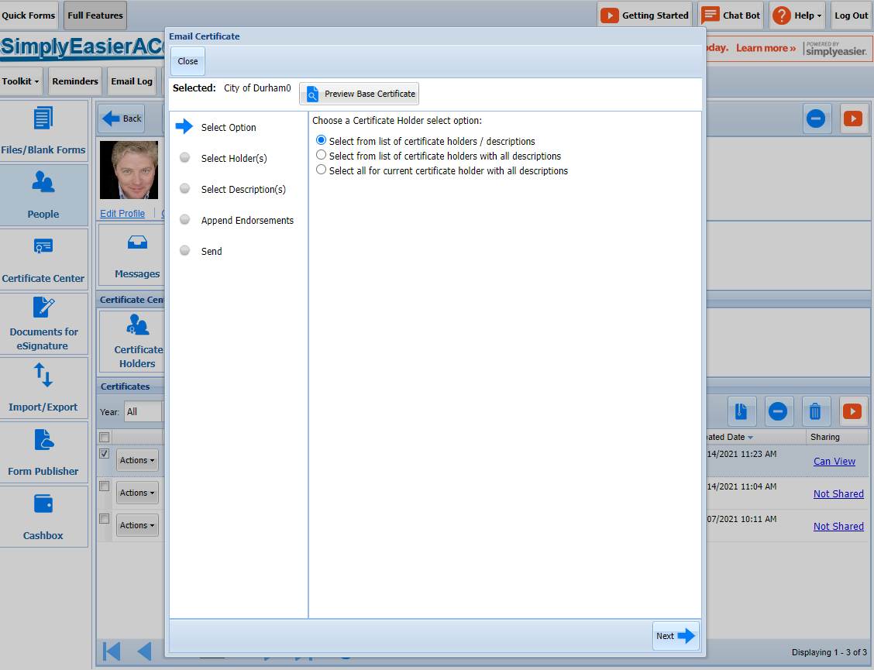
Certificate Center – Email Certificate
Select the option you want to use

Slide 32
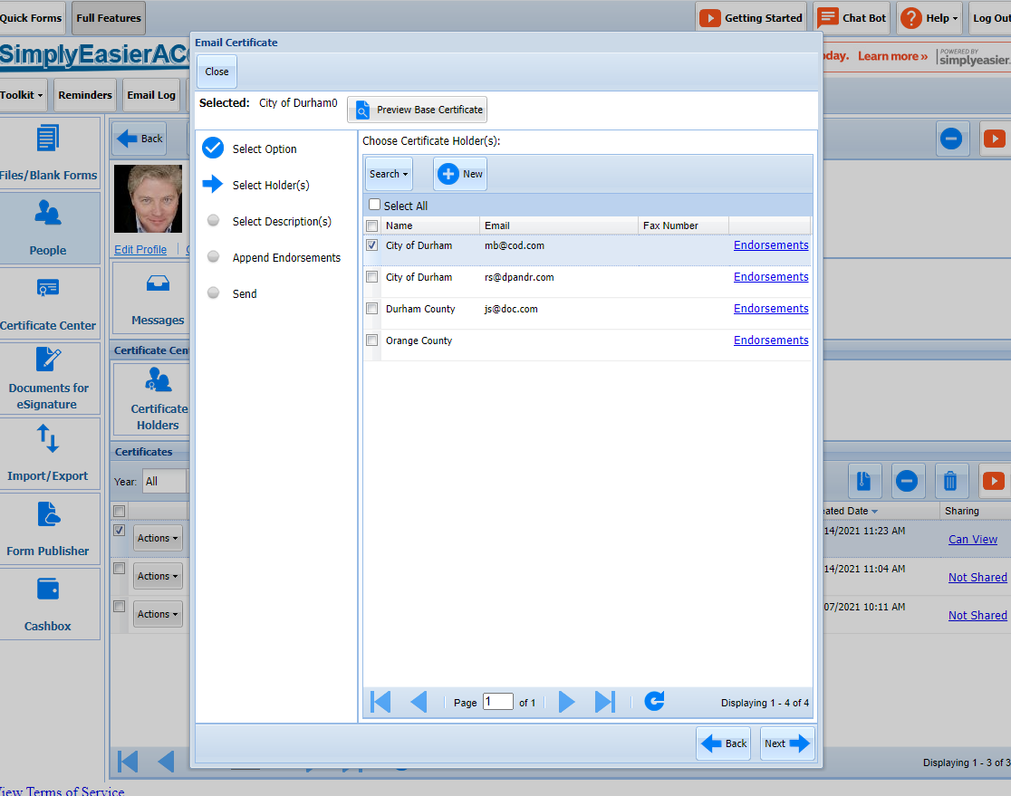
Certificate Center – Email Certificate
Select the Certificate Holders to whom you wish to email certificate.

Slide 33
Certificate Center – Email Certificate
UNIQUE FEATURE!!!
If you click on the Endorsement link you can attach any other PDF you upload from your PC to this Certificate.
In our example we are going to add a copy of the Add’l Insured Endorsement
Endorsements

Slide 34
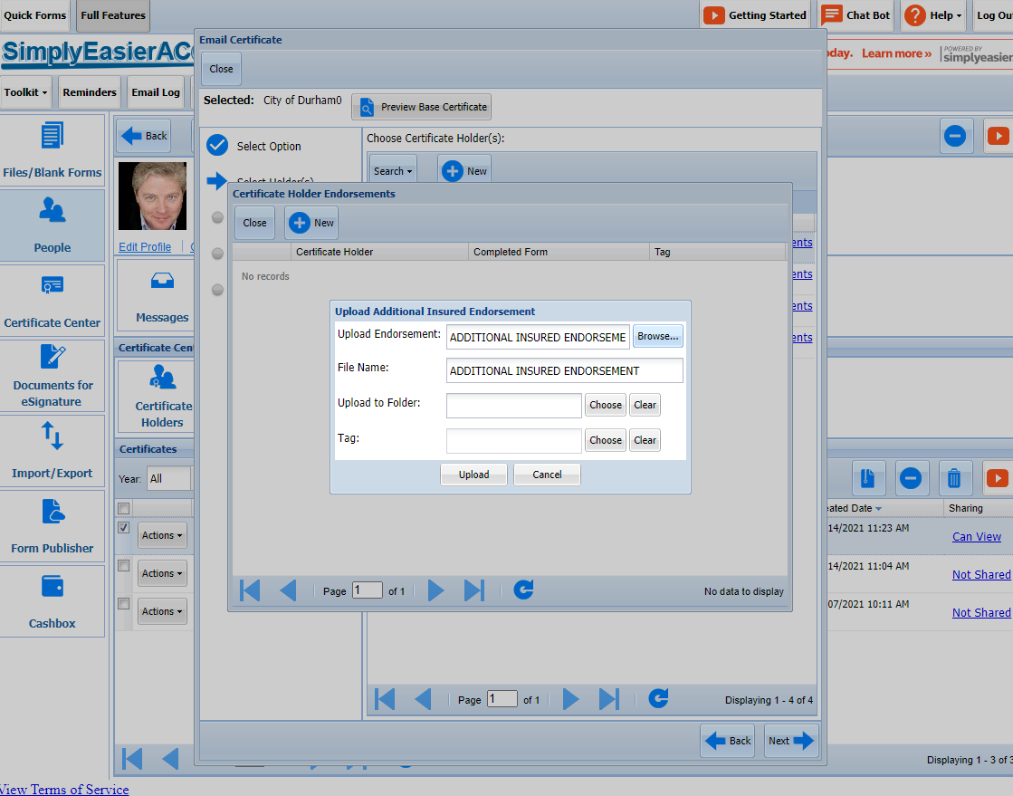
Certificate Center – Email Certificate
After clicking on the Endorsement Link, Click on the “New” Button
Work through the Upload screen.
The TAG is the name the document will be stored under

Slide 35
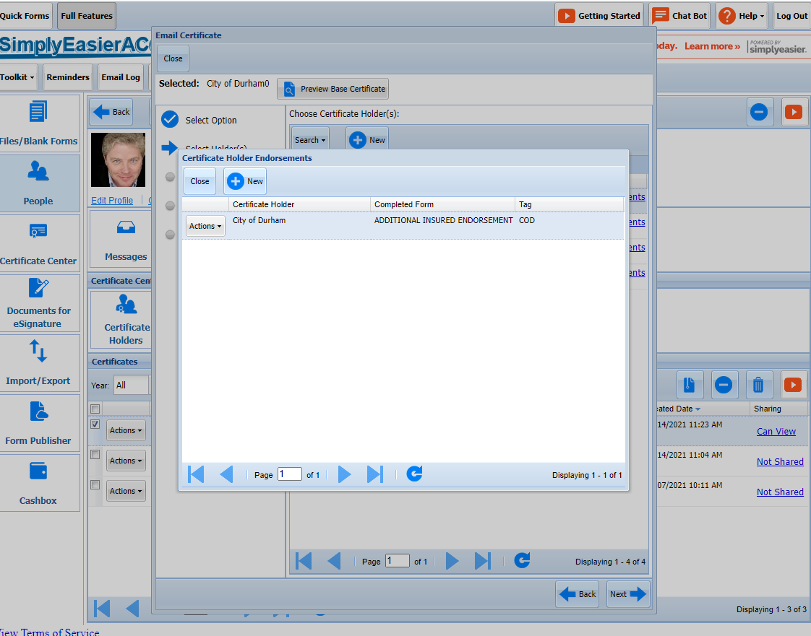
Certificate Center – Email Certificate
You will see the uploaded form.
Click Close.

Slide 36
Certificate Center – Email Certificate
This returns you to the Selection of Certificate Holders
Click Next

Slide 37
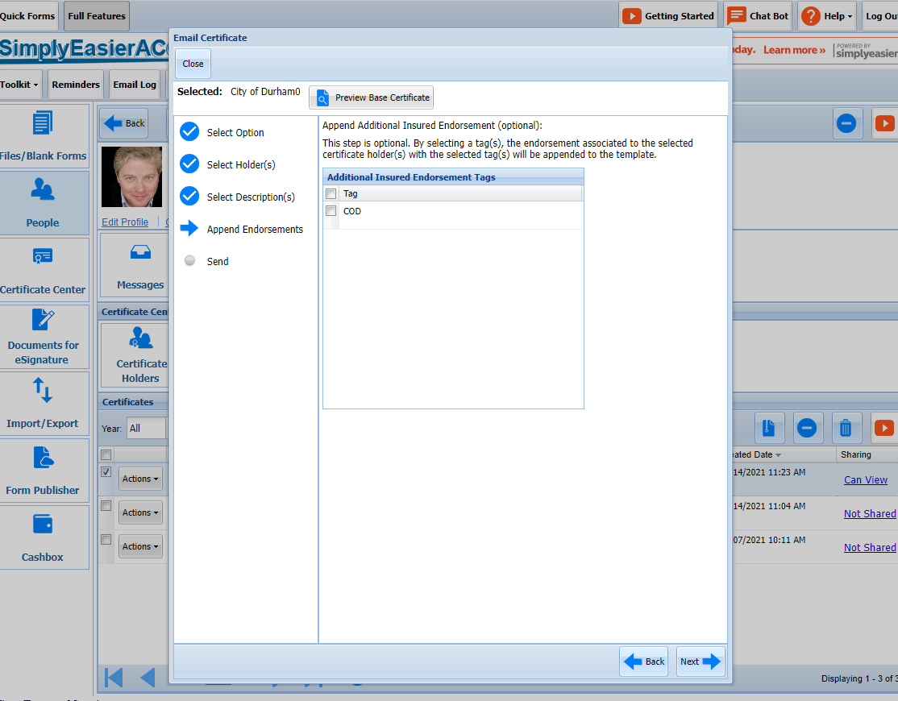
Certificate Center – Email Certificate
This is where you attached the uploaded Endorsement Form to the Certificate

Slide 38
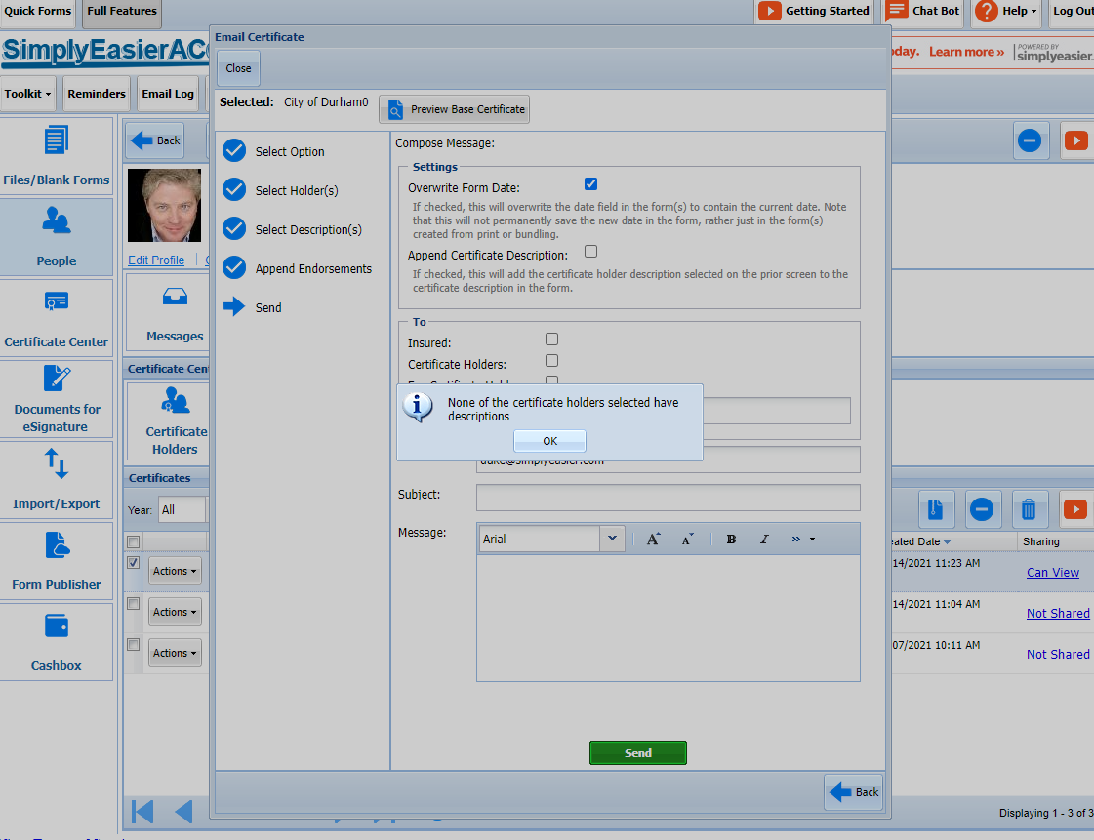
Certificate Center – Email Certificate
If the Certificate has no Description you get a notice at this step.
As you know, all, even most, Certificate do not have Descriptions
Click Next

Slide 39
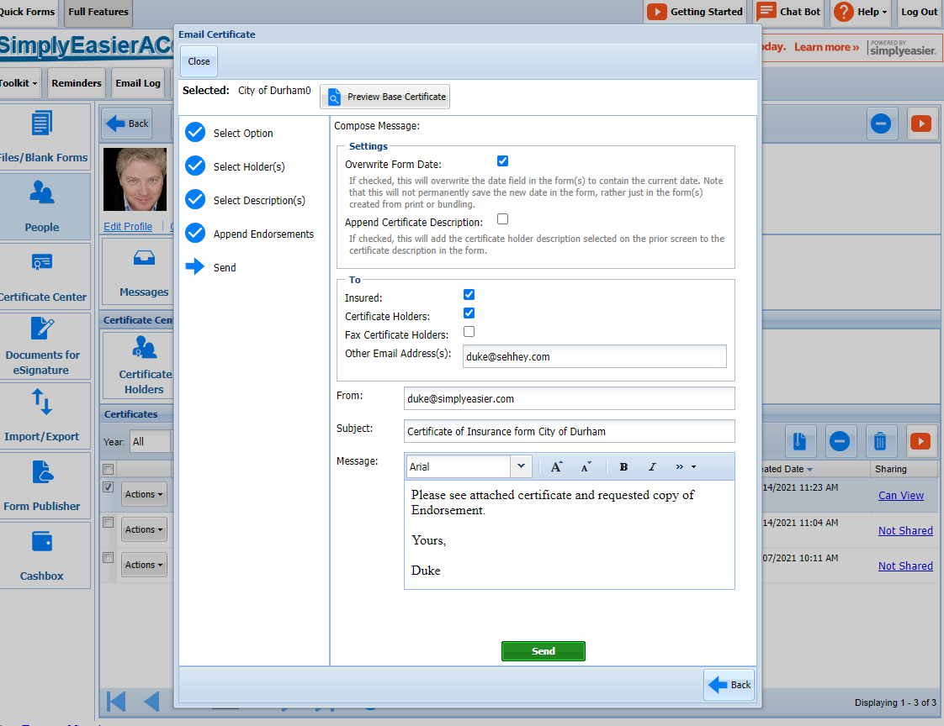
Certificate Center – Email Certificate
Complete the email screen.
You can email this to as many email addresses as you wish.
Add a Subject Line and Body content.
You may want to let your email recipients know to check their spam folders

Slide 40
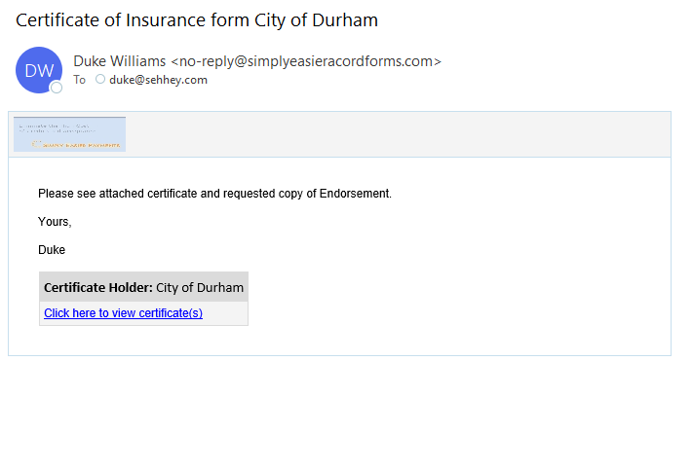
Certificate Center – Email Certificate
Here is the email the Certificate Holder and the Insured will receive
They click on the link to see the Certificate – much more secure than using an attachment.

Slide 41
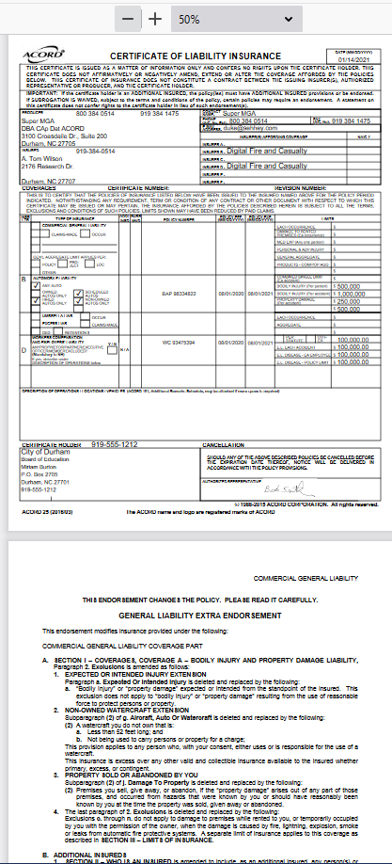
Certificate Center – Email Certificate
Here is the Certificate and the attached endorsement

Slide 42
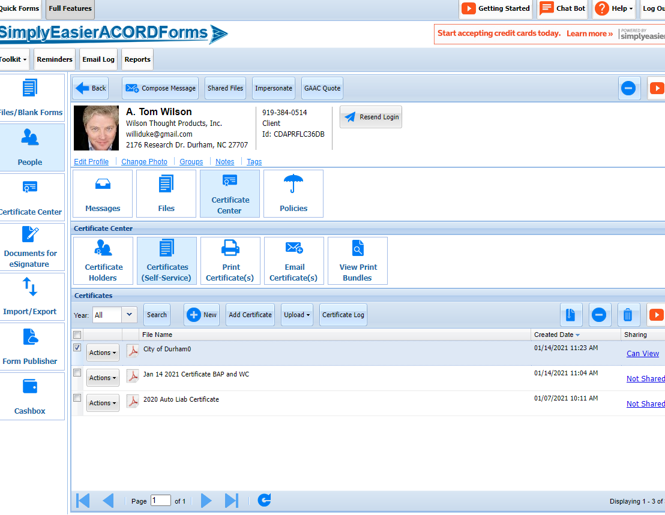
Certificate Center – Certificate Log
Every Emailed Certificate issued from the system create a permanent Audit Trail Log entry
Click on “Certificate Log”
Certificate Log

Slide 43
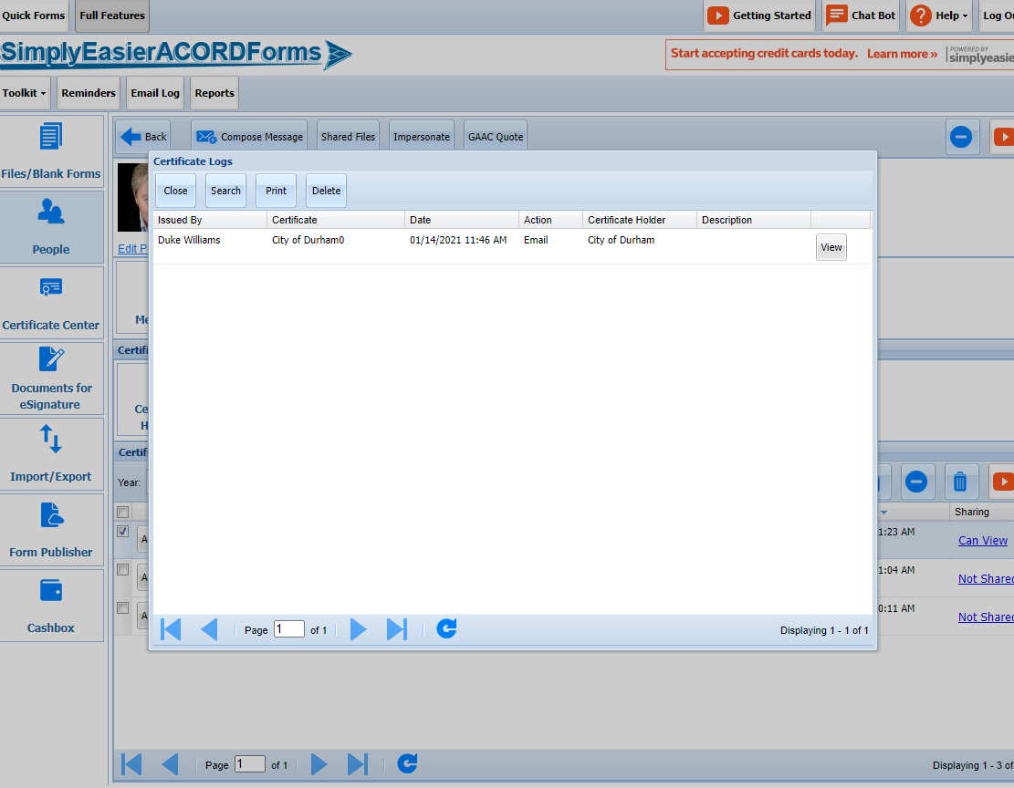
Certificate Center – Email Certificate
It shows a time / date stamped record of when the certificate was emailed.
Click on the “View” button to see the actual copy of the sent Certificate

Slide 44
Certificate Center – Email Certificate
2 Ways to Create Certificate
From New Blank Forms
From Certificate Center
Which to Use
If you just need one Certificate ever for this insured, use New Blank Forms
If you will be issuing more than one certificate ever, use Certificate Center

